Slide 1

MORSE AID APP
Abheek shah
Ty BSc (CS)

Slide 2

BREIF
The Morse Aid app is an all-purpose utility that assists users in translating Morse code, signaling distress, and accessing emergency services. It offers a range of features designed to facilitate communication in urgent situations and support Morse code enthusiasts.

Slide 3
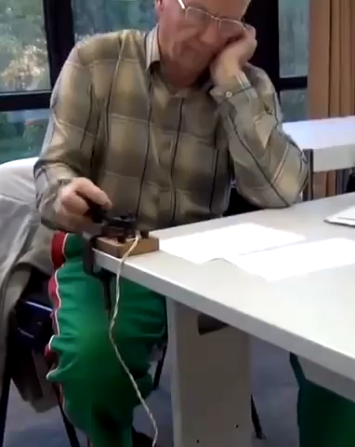
PROJECT IDEA
What you saw in this video was Morse code communication. I’m passionate about communication technologies like SSTV, RF, IR, and more. This inspired me to create a Morse code app with added features, combining practicality and innovation for enthusiasts and emergency use.

Slide 4



REAL LIFE USE CASE
Morse Aid provides emergency communication through light or sound signals, quick access to emergency numbers, SOS signaling in survival situations, Morse code learning for enthusiasts, and a reliable assistive tool for individuals with speech or hearing impairments in critical situations.

Slide 5
PLUS POINTS
During the development of this app, I reviewed similar applications, which only offer basic Morse code features. My app prioritizes reliable emergency communication, ensuring compatibility with various Android versions, using simple Java logic, offline functionality, and no sign-in requirements.

Slide 6
DIFFICULTIES FACED
Code Simplicity: Balancing simplicity and functionality in the code was challenging.
App Package Size: Optimizing package size for quick downloads and performance.
Emergency Color Codes: Researching appropriate emergency color codes due to lack of official guidelines in India.
Compatibility Across Devices: Ensuring consistent functionality across various Android devices and versions.
Accessibility Features: Designing for color blindness and other disabilities required extensive testing and consideration.

Slide 7
PROJECT FUTURE
Future plans for the Morse Aid app include expanding features like voice-to-Morse conversion, adding multiple language support, implementing real-time location sharing, developing cross-platform versions for iOS and Linux, ensuring regular updates, and partnering with emergency services for enhanced functionality.

Slide 8
THANK YOU
ANY QUESTIONS

